Slide 1
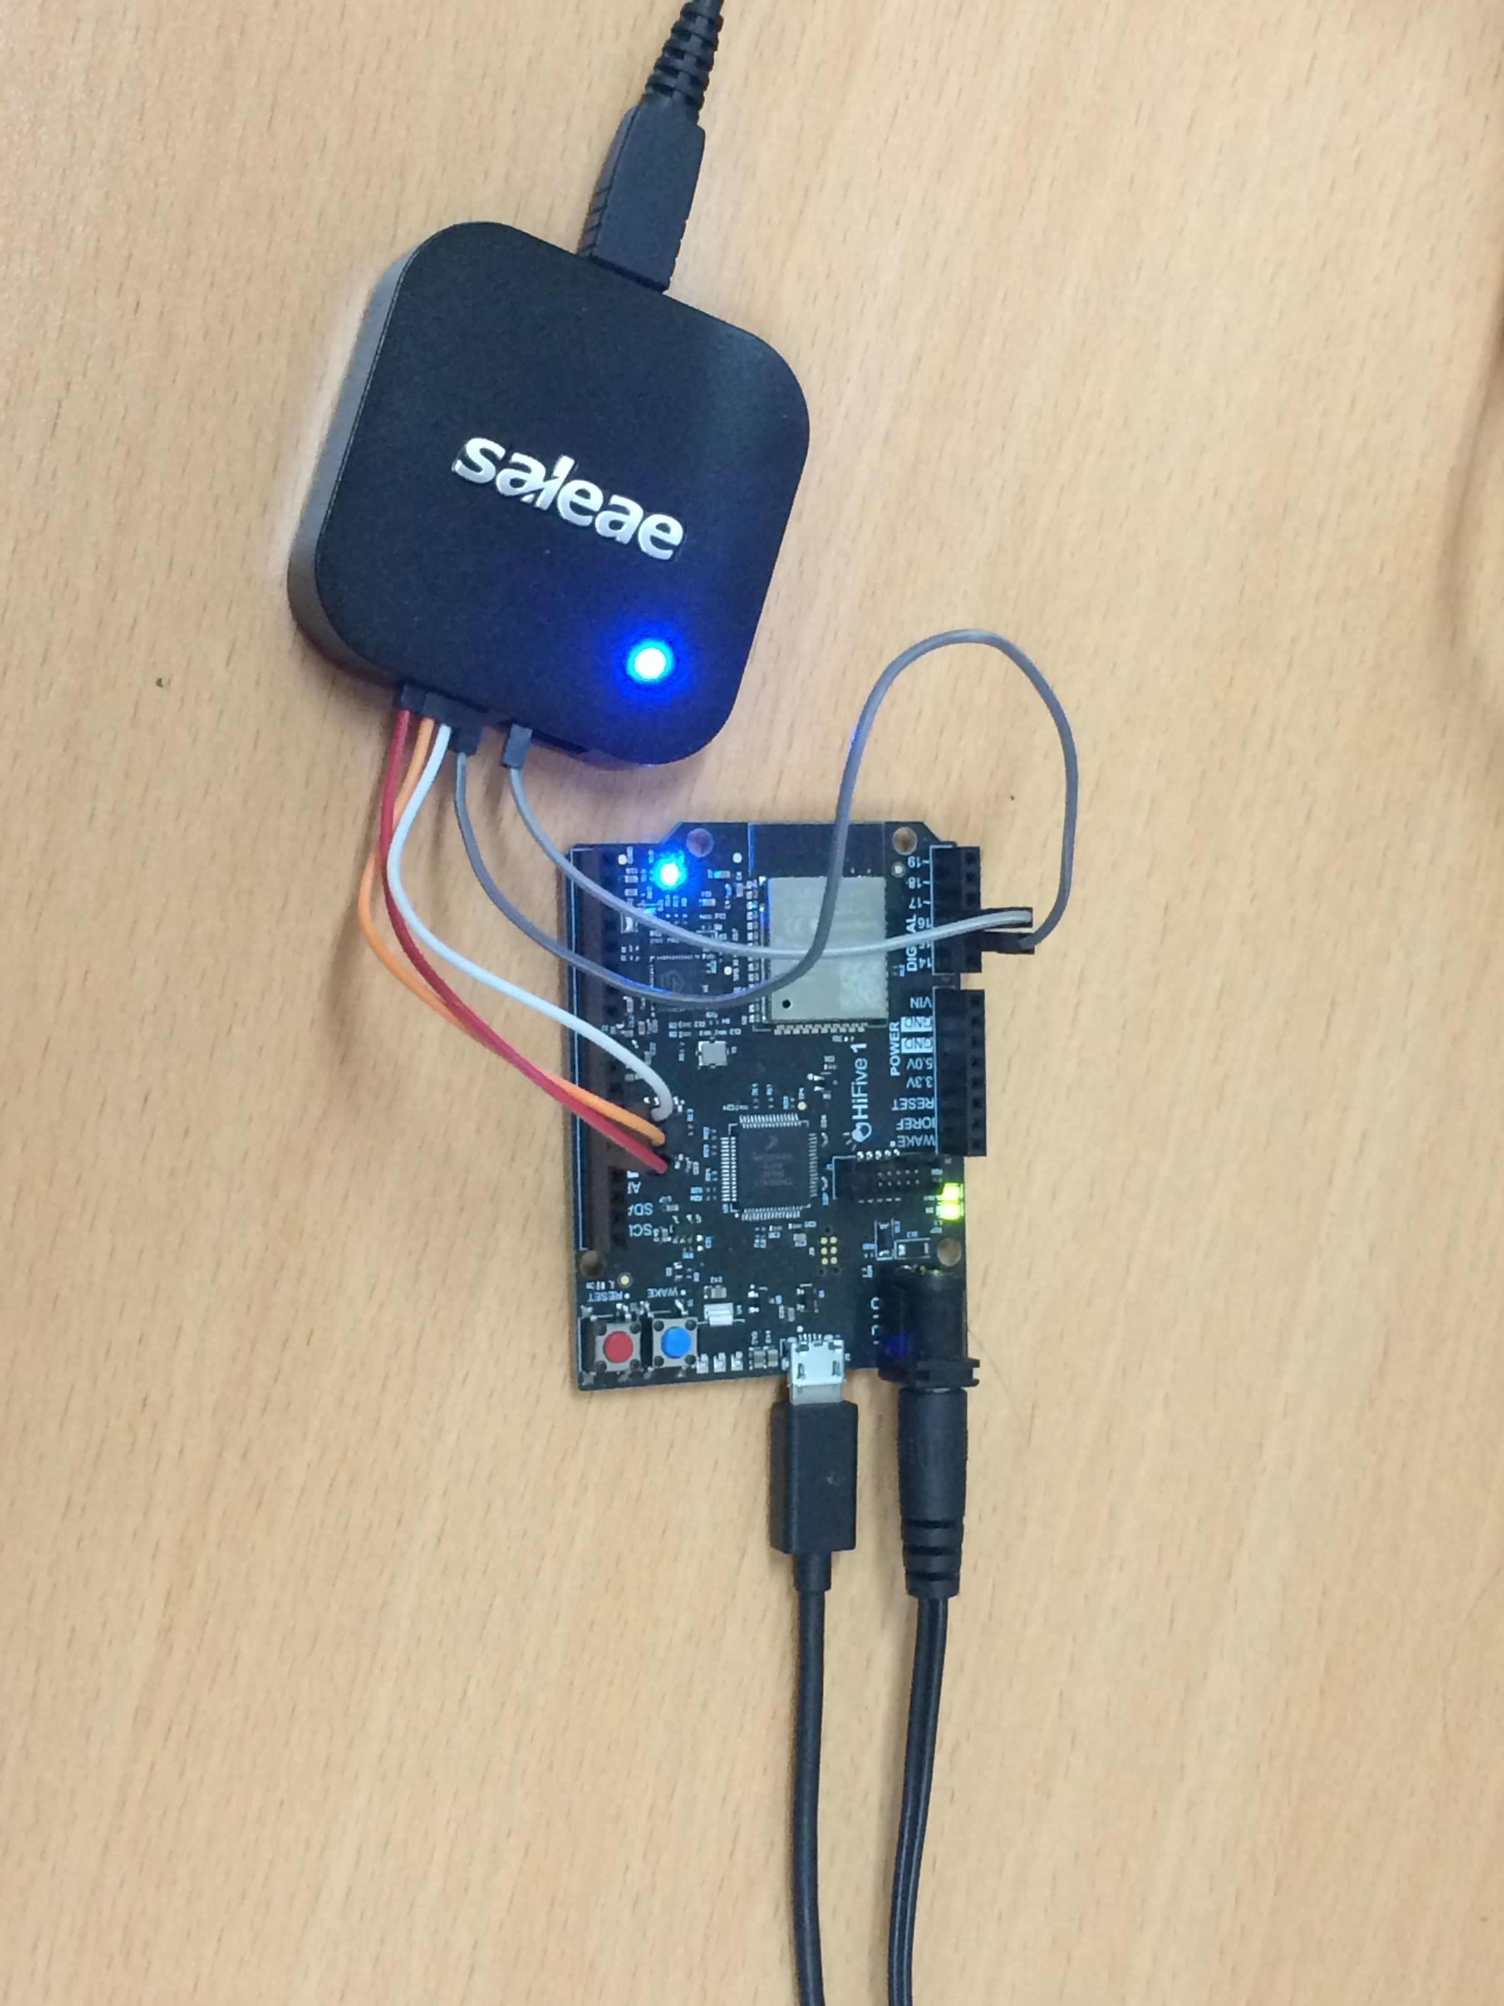
HiFive1 demo How to modify AWS S3 data
Nov-11-2019
private documentary

Slide 2
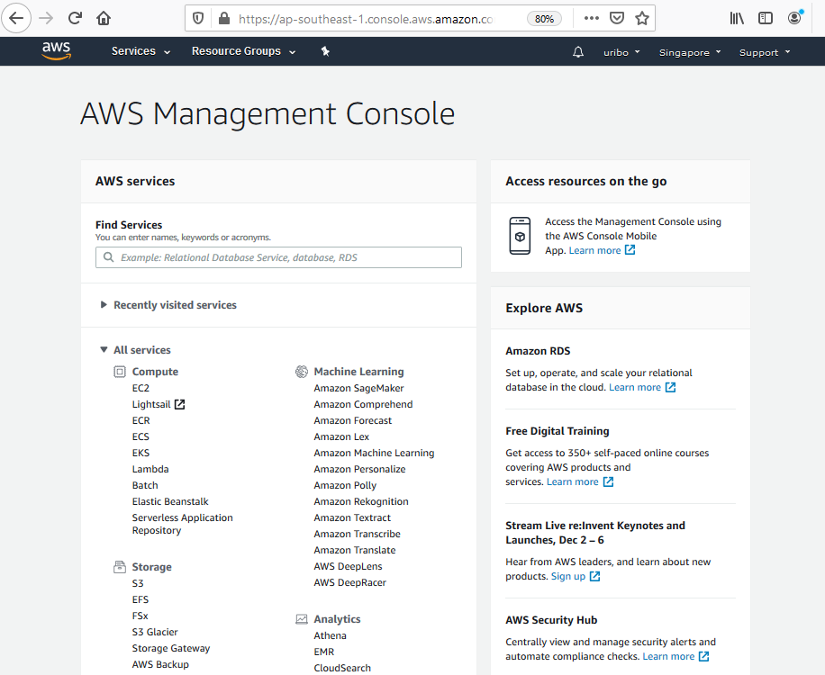
Log in to AWS S3
Go to https://aws.amazon.com/console/
Click Sign In to the Console
Log in AWS
Account: yuri.nunami@swhwc.com
Password: Uribo2018
Go to AWS Management Console
URL: https://ap-southeast-1.console.aws.amazon.com/console/home?region=ap-southeast-1
Select S3 service

Slide 3
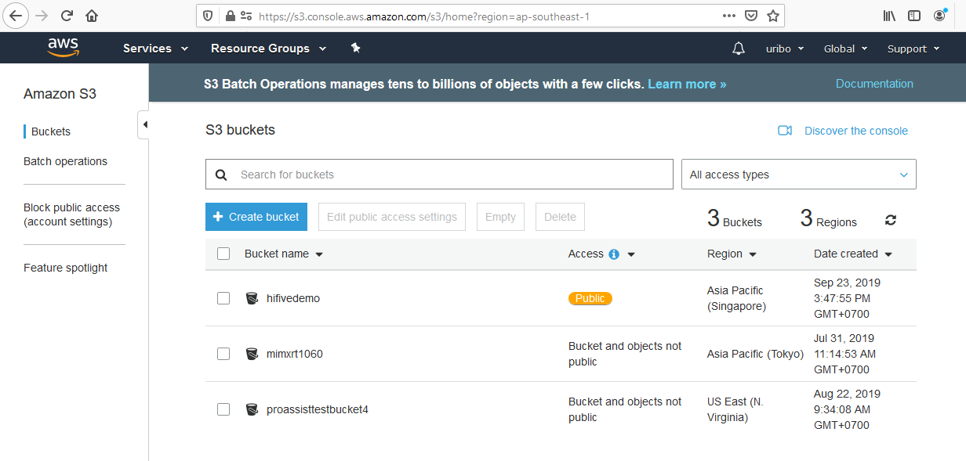
HiFive1 demo
Url: https://s3.console.aws.amazon.com/s3/home?region=ap-southeast-1

Slide 4
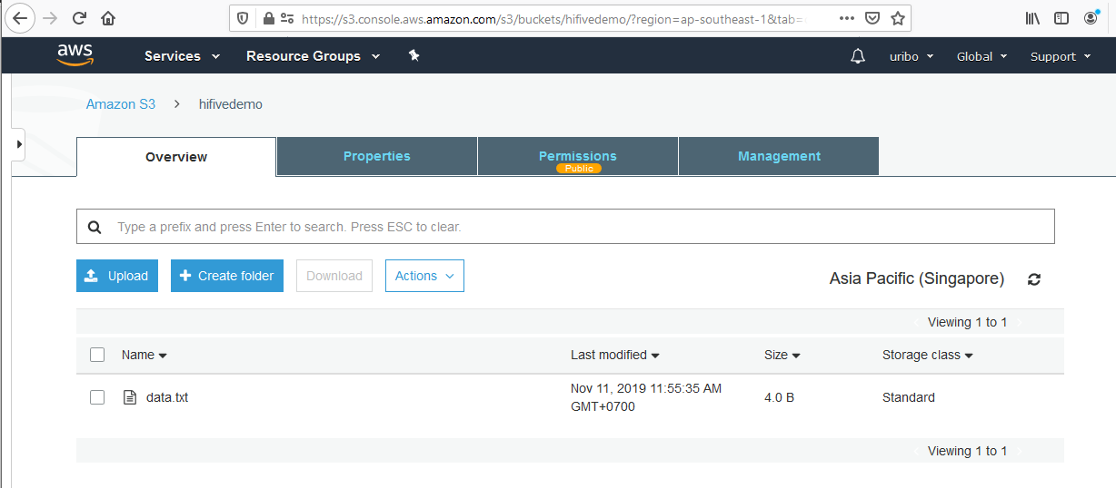
Upload data.txt
Url: https://s3.console.aws.amazon.com/s3/buckets/hifivedemo/?region=ap-southeast-1&tab=overview
Click Upload or Drag and Drop data.txt file from your file system into this site
Remember to Make Public after every Uploads

Slide 5
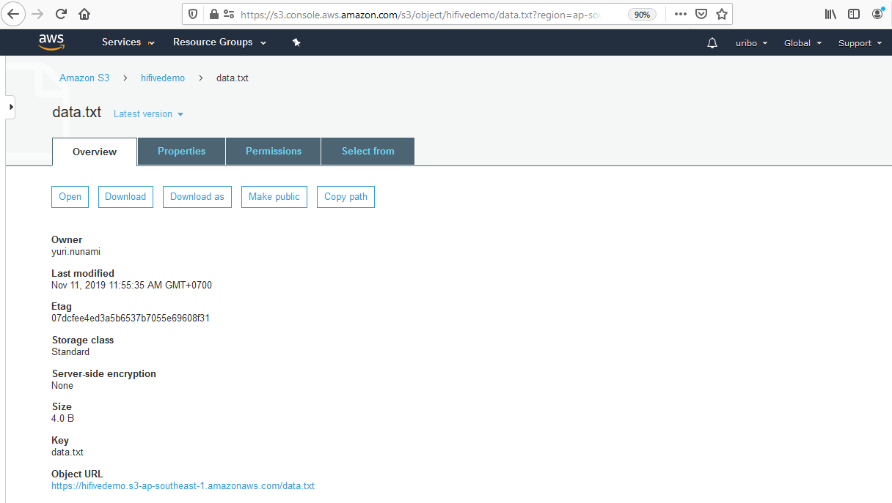
Download data.txt
URL: https://s3.console.aws.amazon.com/s3/object/hifivedemo/data.txt?region=ap-southeast-1&tab=overview
To Download data.txt, click Object URL link
https://hifivedemo.s3-ap-southeast-1.amazonaws.com/data.txt
Remember to click Make Public after every Uploads
View content of data.txt
data.txt only store “LEDB” or “LEDR” or “LEDG” string

